Slide 1
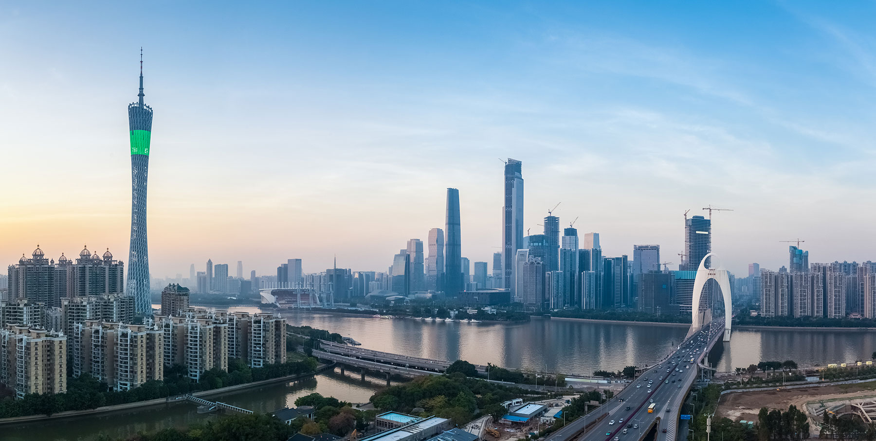
Home page: https://xxx/ieds/home
Home
The 1st Institute of Electron Device Society
August 2-4, 2017, Guangzhou, China
Lecturers
Program
Committee
Contacts
Welcome.

Slide 2
Lecturers page
Home
The 1st Institute of Electron Device Society
August 2-4, 2017, Guangzhou, China
Lecturers
Program
Committee
Contacts
H.–S. Philip Wong, Stanford University
Wai Tung Ng, Toronto University
Simon Deleonibus, Secretary of IEEE Electron Society
Hong Guo, McGill University
Mansun Chan, HongKong University of Science and Technlogy
Bin Yu, State University of New York
Jinbin Xu, The Chinese University of HongKong.

Slide 3
Program page
Home
The 1st Institute of Electron Device Society
August 2-4, 2017, Guangzhou, China
Lecturers
Program
Committee
Contacts
Day One:
Morning: Introduction and invited opening talk
Morning:: Short course by Simon Deleonibus on Nano CMOS Technology
Afternoon: Short course by Mansun Chan on Nano-engineering Research Methodology
Day Two:
Morning: Short course by WaiTung Ng
Afternoon: Short course by Hong Guo on Theoretical Nanoelectronics
Day Three:
Morning: Short course by Bin Yu on Nanoscale Electronics
Afternoon: Short course by Jianbin Xu on Nanoscale Photonics
Closing ceremony:
Best post award

Slide 4
Committee page
Home
The 1st Institute of Electron Device Society
August 2-4, 2017, Guangzhou, China
Lecturers
Program
Committee
Contacts
Lining Zhang (Hong Kong University of Science and Technology)
Shaolin Zhou (South China University of Technology)
Changjian Zhou (South China University of Technology)
Bin Li (South China University of Technology)
Mansun Chan (Hong Kong University of Science and Technology)

Slide 5
Contacts page
Home
The 1st Institute of Electron Device Society
August 2-4, 2017, Guangzhou, China
Lecturers
Program
Committee
Contacts
Prof. Lining Zhang
Dept. of ECE, Hong Kong University of Science and Technology
Clear Water Bay, Kowloon, Hong Kong
Email: eelnzhang@ust.hk
Fax: +852-23581485
Prof. Shaolin Zhou
School of EIE, South China University of Technology
Tianhe District, Guangzhou
Email: eeslzhou@scut.edu.cn

